Slide 1
碰撞检测-GJK算法
Collision Detection - The Gilbert-Johnson-Keerthi algorithm
自卓 1901 谢昊辰

Slide 2
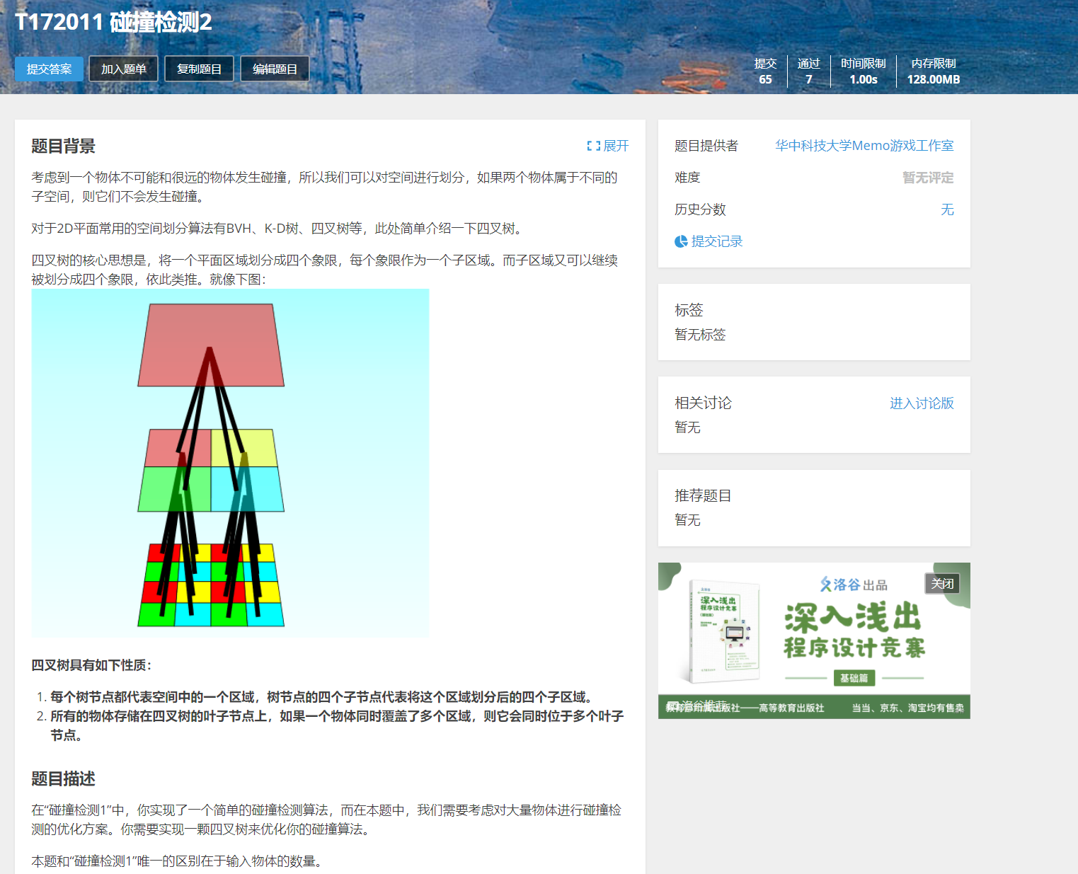
先从一道题说起

Slide 3
主要内容
Contents
PART 01
碰撞检测简介
PART 02
GJK算法
PART 03
Q&A

Slide 4
01
碰撞检测简介

Slide 5
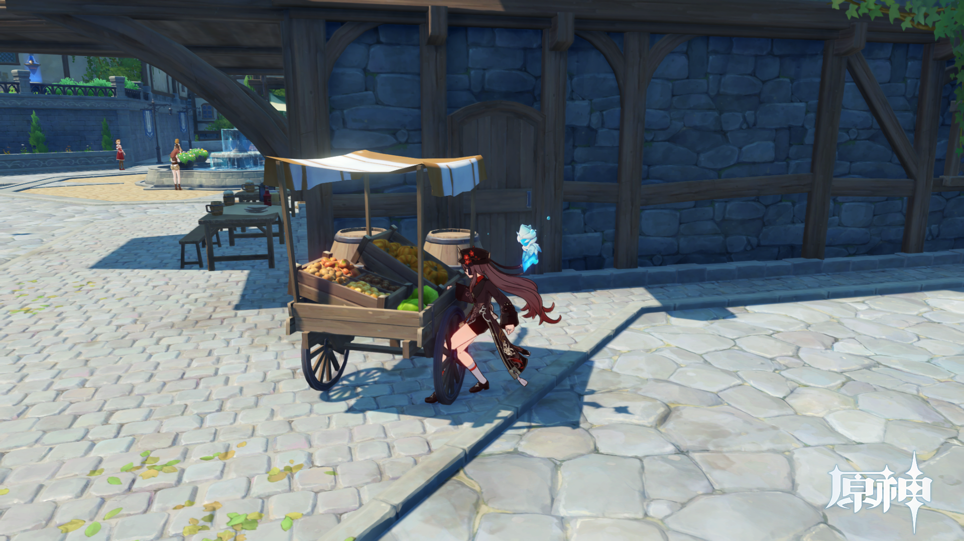
Collision Detection
游戏中的物体会与环境，玩家，以及其他物体碰撞。

Slide 6
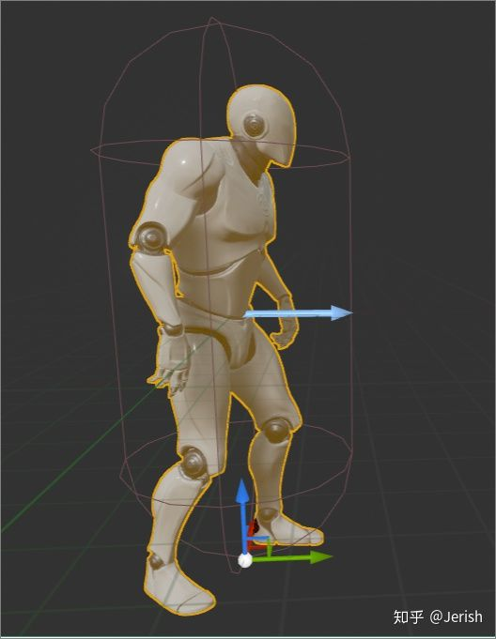
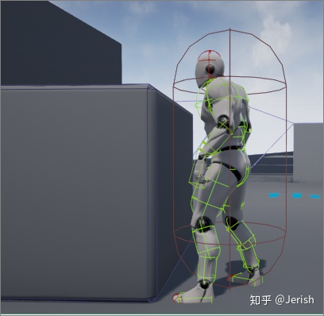
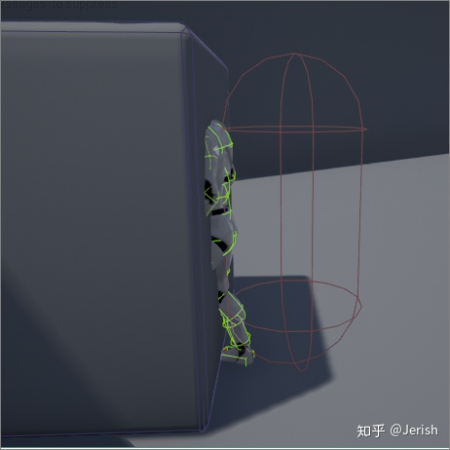
Collision Detection
一般地，3D游戏中的物体由两个独立地网格(图形)组成。

Slide 7
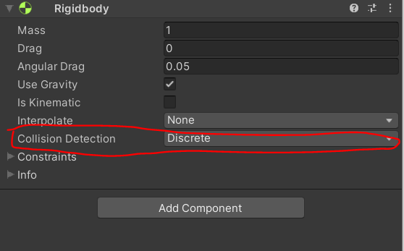
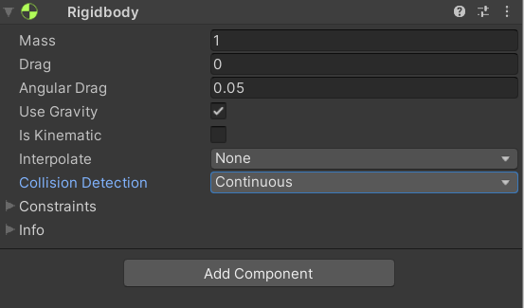
Collision Detection
Continuous & Discreate Collision Detection

Slide 8
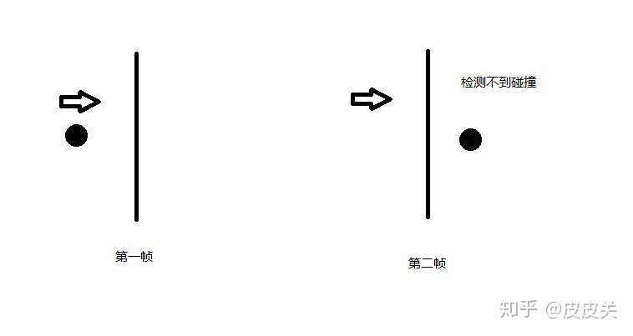
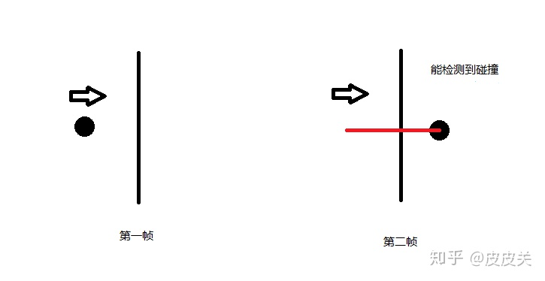
Collision Detection
Continuous & Discrete Collision Detection

Slide 9
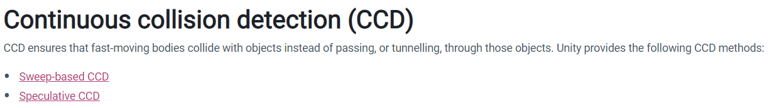
Collision Detection
Continuous Collision Detection
https://docs.unity3d.com/Manual/ContinuousCollisionDetection.html

Slide 10
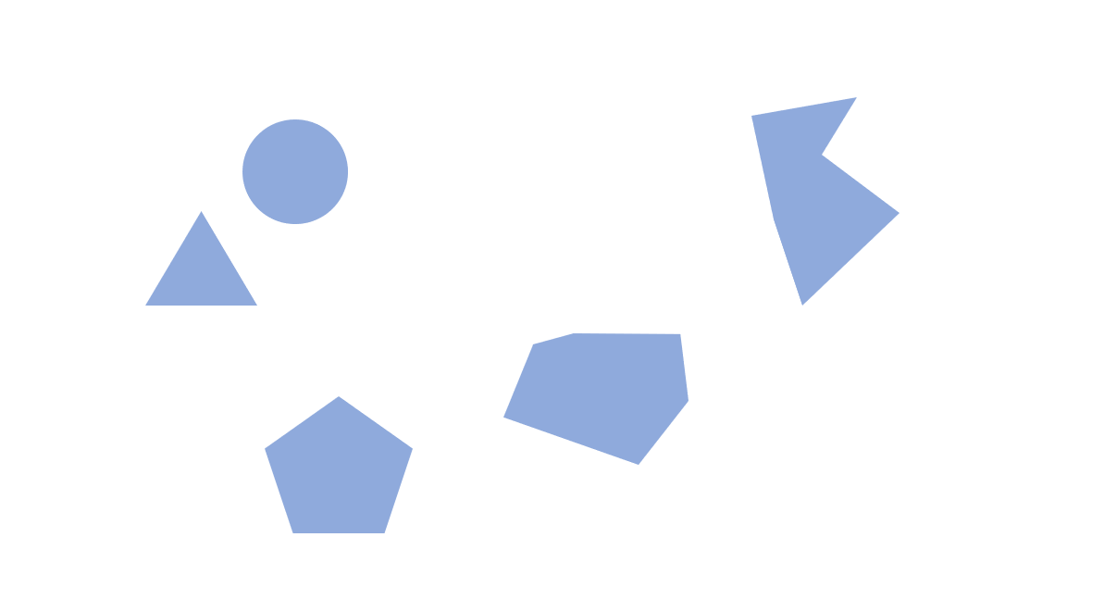
Collision Detection
Discrete Collision Detection

Slide 11
Collision Detection
Broad-Phase & Narrow-Phase
场景中的物体形状都是多边形，这造成了碰撞检测的困难，因此我们可以使用一种简化的易于检测的图形去暂时代替物体，当两个简化的图形没发生相交，那么我们可以马上推断其相应的物体没有发生碰撞。
所以我们将碰撞检测分成两个阶段来实现,Broad-Phase和Narrow-Phase.
Broad-Phase使用某种Bounding Volume来表示刚体的碰撞信息,然后用空间划分的方式来保存这些Bounding Volume,就可以再较短的时间内筛选出可能互相碰撞的刚体对.
Narrow-Phase就是将这些刚体对进行真正的碰撞检测.

Slide 12
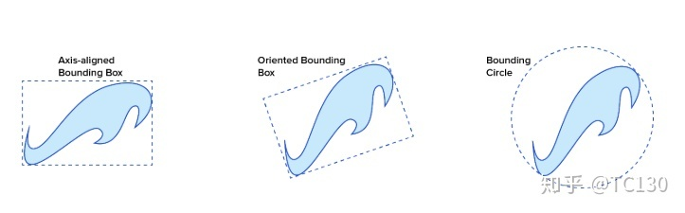
Collision Detection
Broad-Phase:Bounding Volume

Slide 13
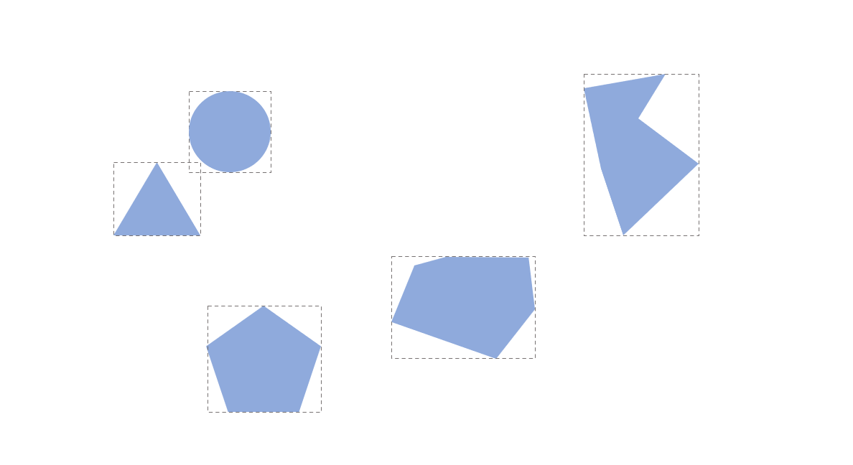
Collision Detection
Broad-Phase:Bounding Volume
Notes:
test

Slide 14
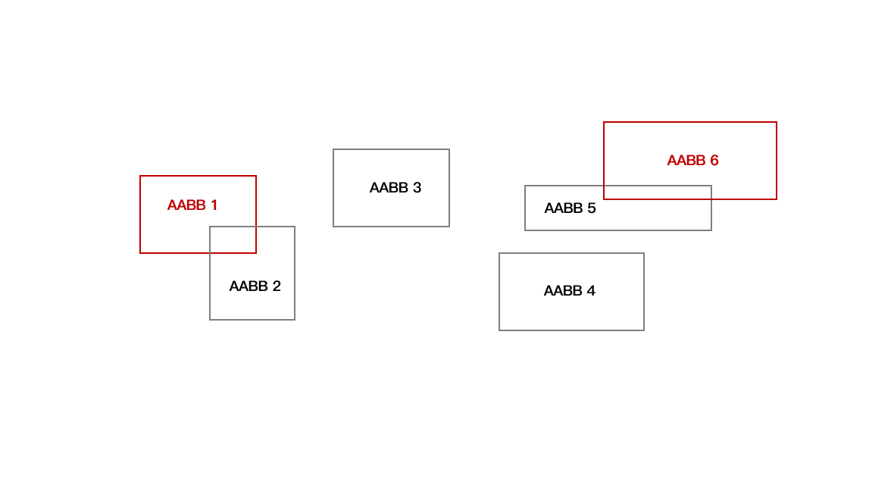
Collision Detection
Broad-Phase
即使 AABB 相交检测很快，我们也不能为对每一个 AABB 进行两两相交检测，因为假如我们有 100 个物体，就需要 100 * 100 次的两两 AABB 相交检测。复杂度为O(n^2)

Slide 15
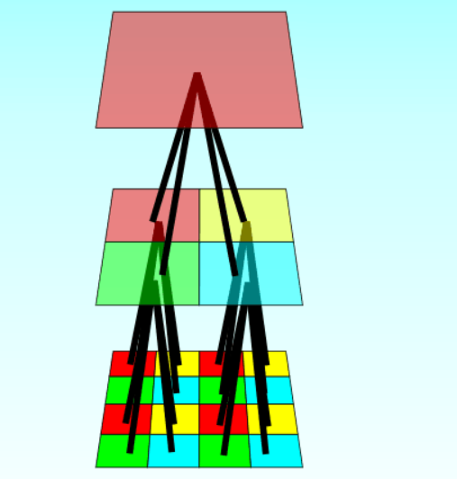
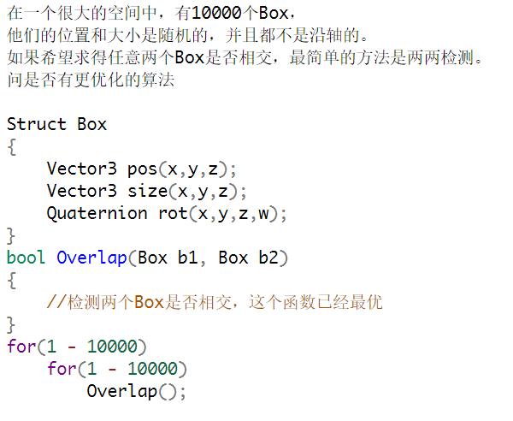
Collision Detection
Broad-Phase : Spatial Partitioning Data Structures

Slide 16
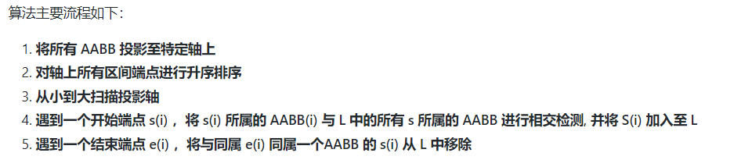
Collision Detection
Broad-Phase : Sweep and Prune Algorithm
http://www.codercorner.com/SAP.pdf
https://github.com/phenomLi/Blog/issues/22

Slide 17
02
GJK算法

Slide 18
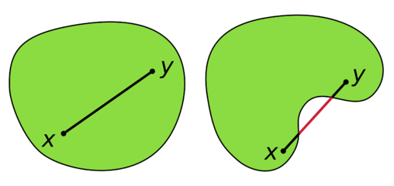
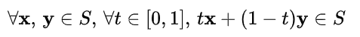
GJK algorithm
GJK算法是一种Narrow-Phase的算法，即其判断碰撞的对象为一般凸多边形。
还有一种常见的Narrow-Phase算法，SAT(分离轴定理)算法。
凸集&非凸集

Slide 19
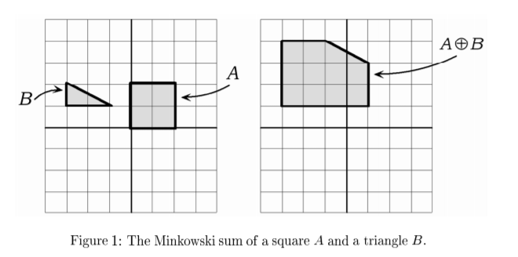
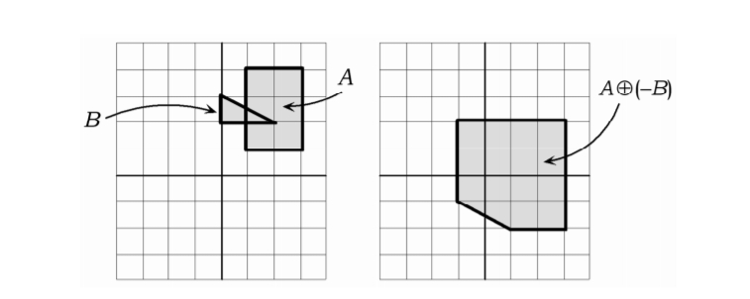
GJK algorithm
Minkowski Difference

Slide 20
GJK algorithm
Minkowski Difference
demo

Slide 21
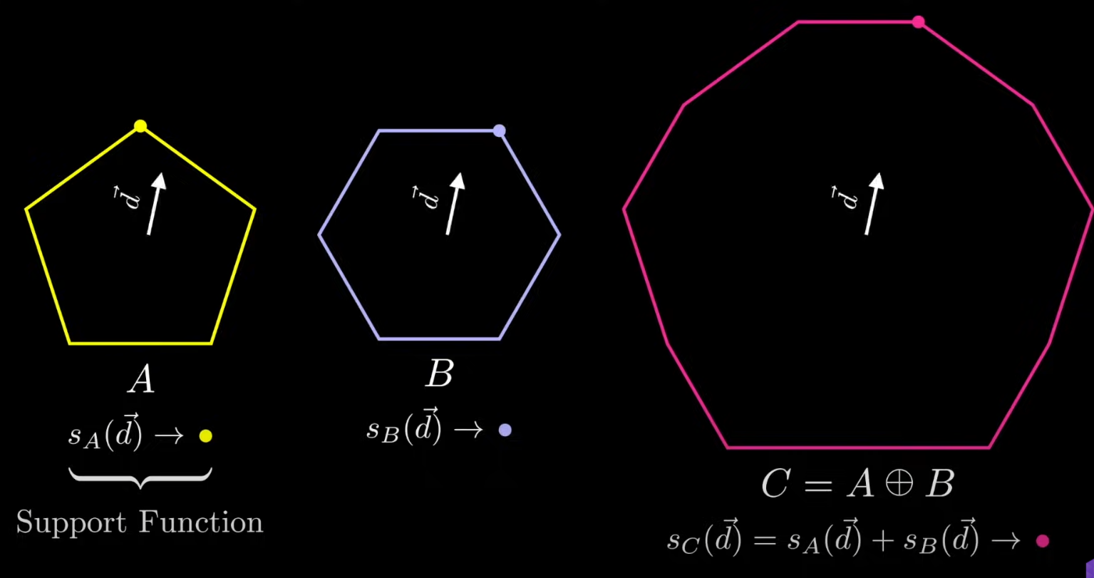
GJK algorithm
Support function

Slide 22
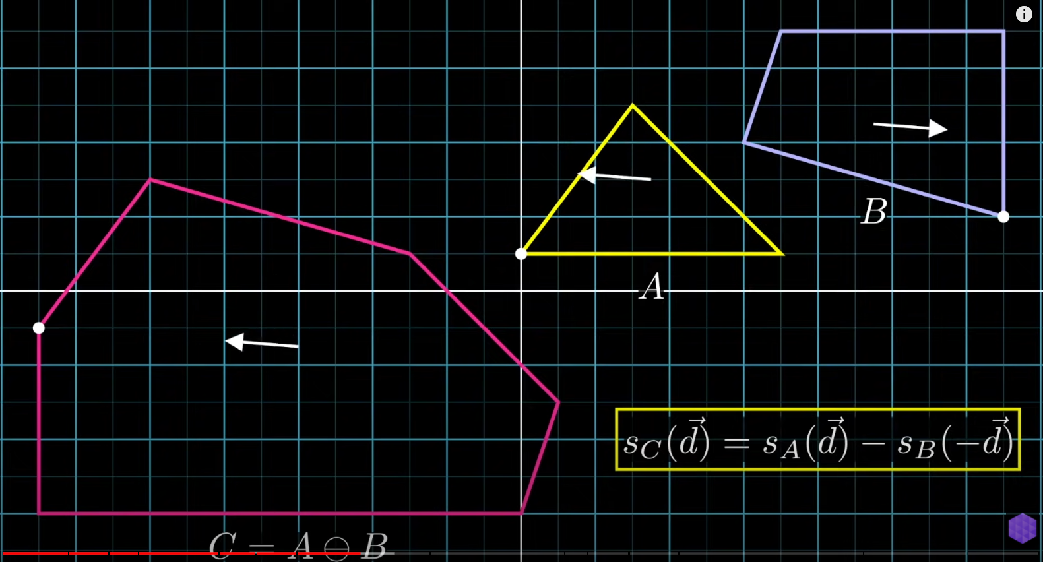
GJK algorithm
Support function

Slide 23
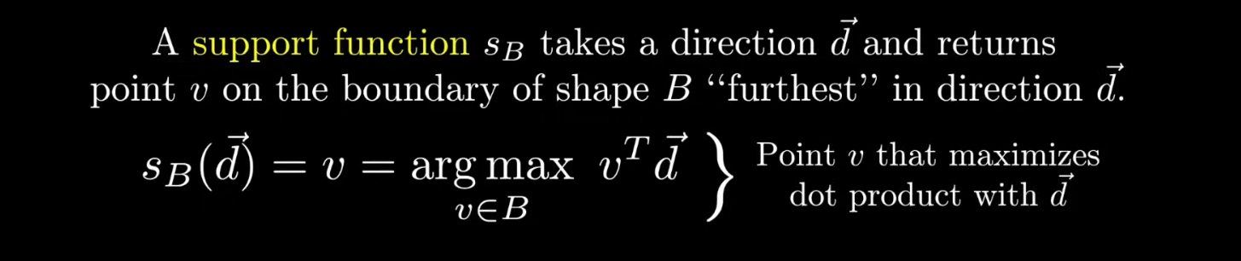
GJK algorithm
Support Function

Slide 24
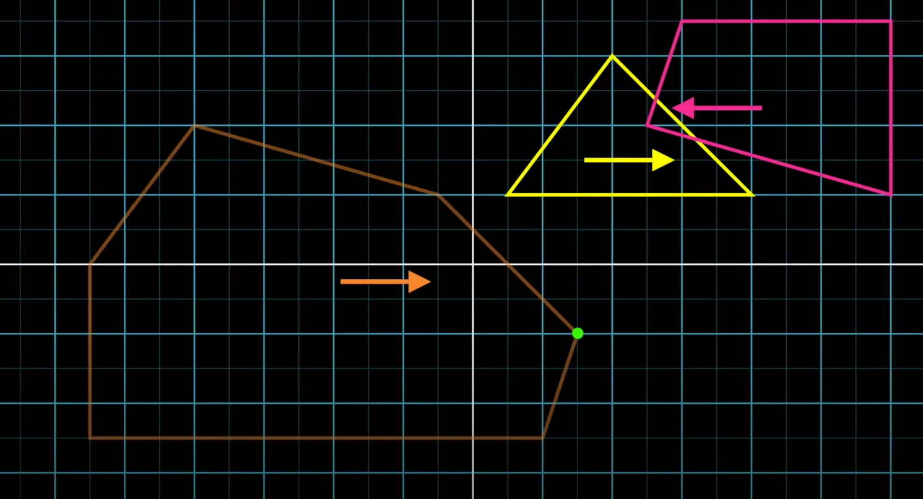
GJK algorithm

Slide 25
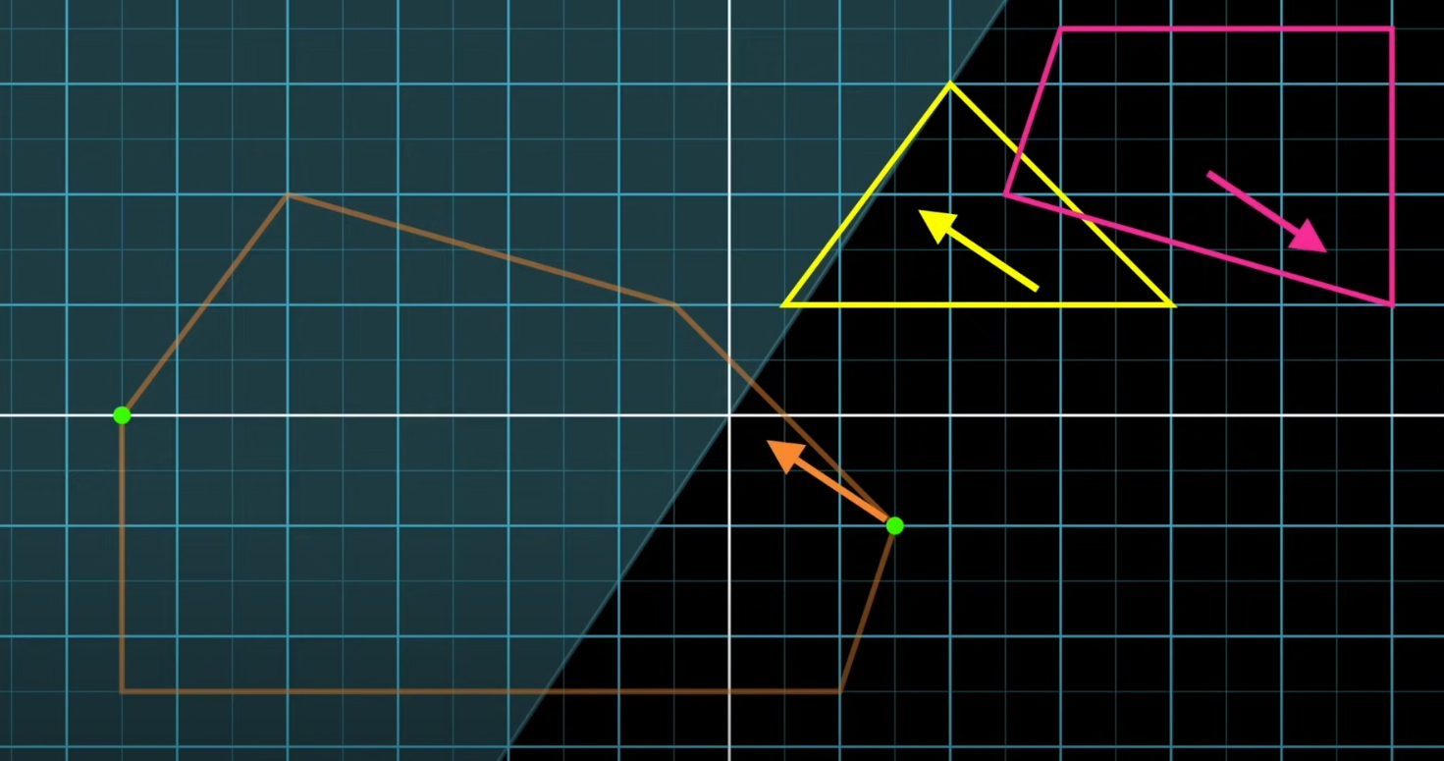
GJK algorithm

Slide 26
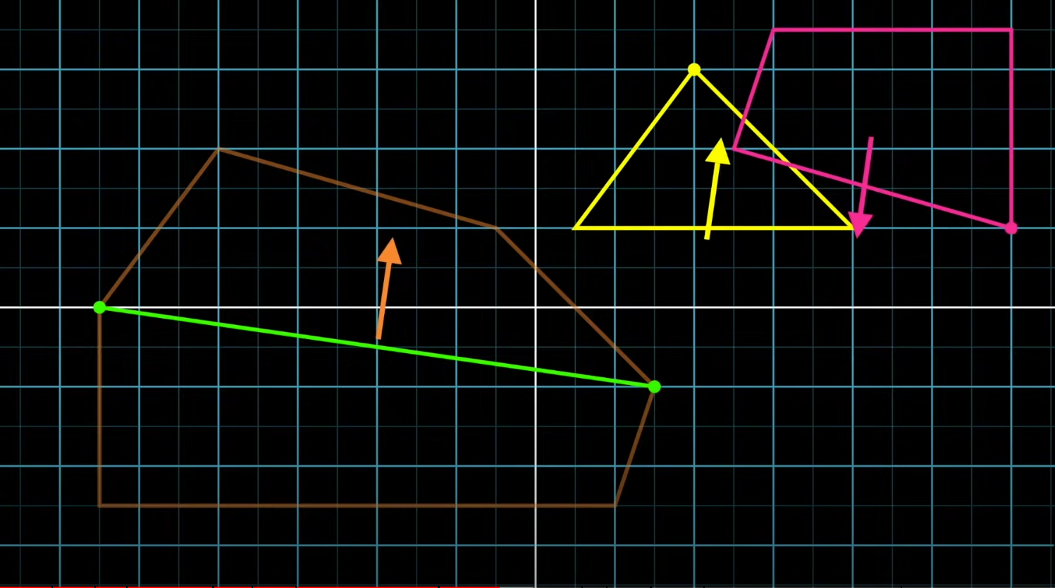
GJK algorithm

Slide 27
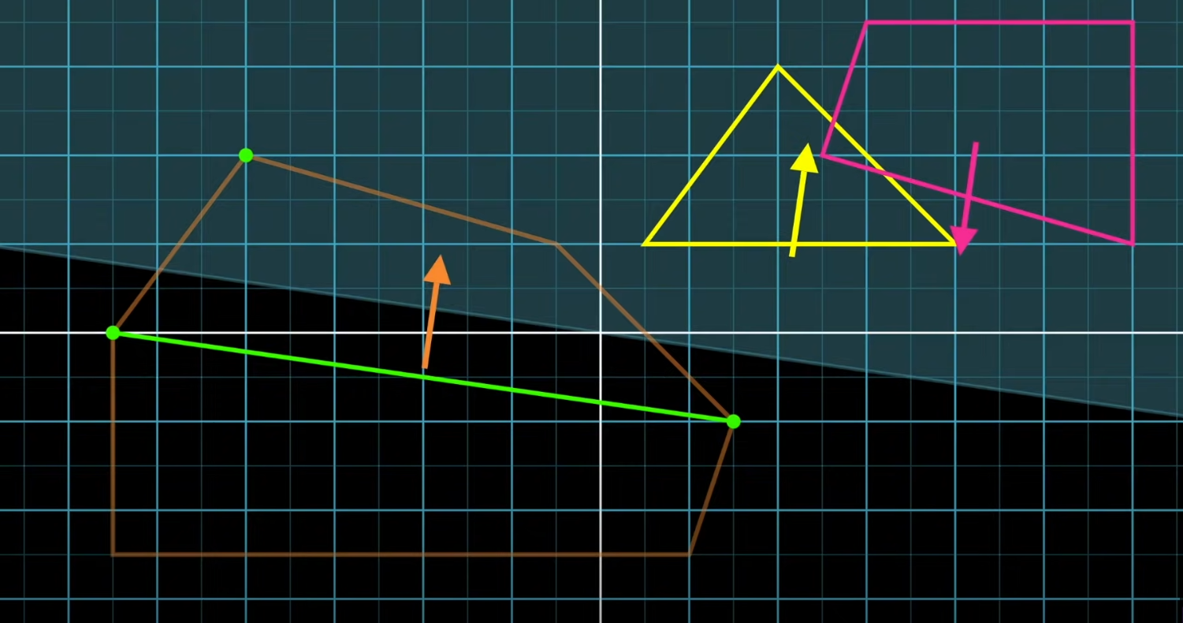
GJK algorithm

Slide 28
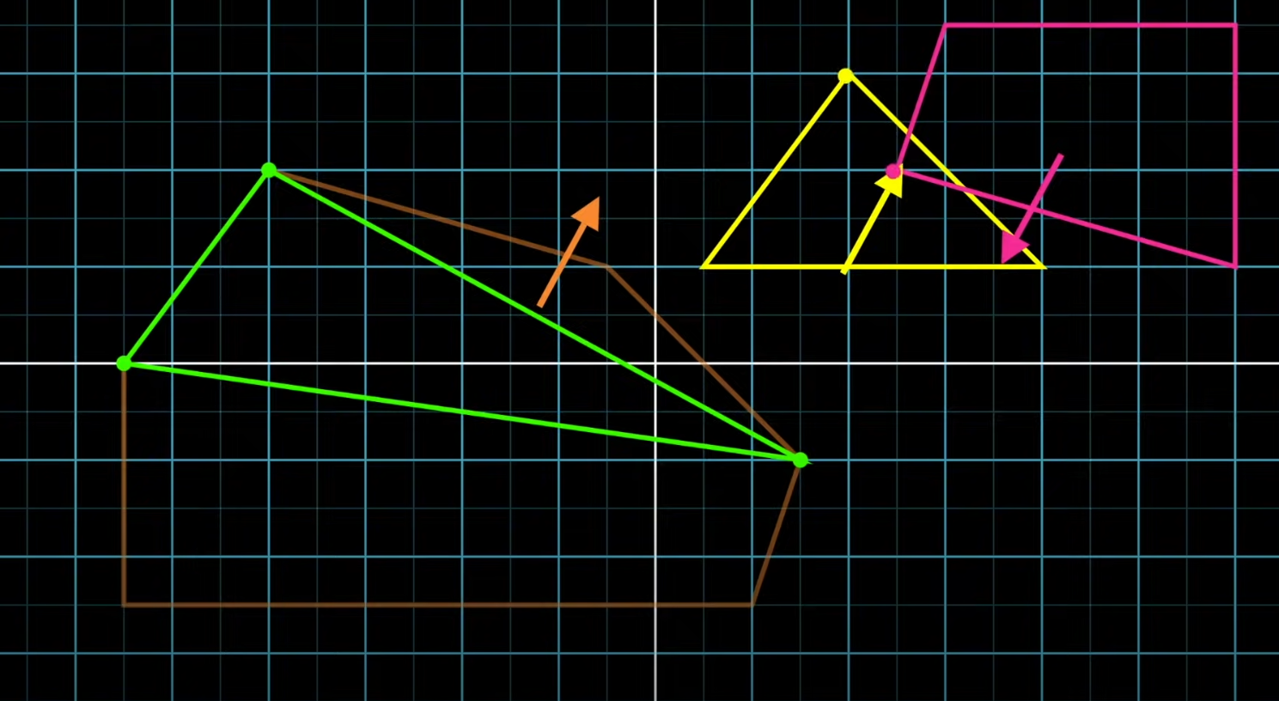
GJK algorithm

Slide 29
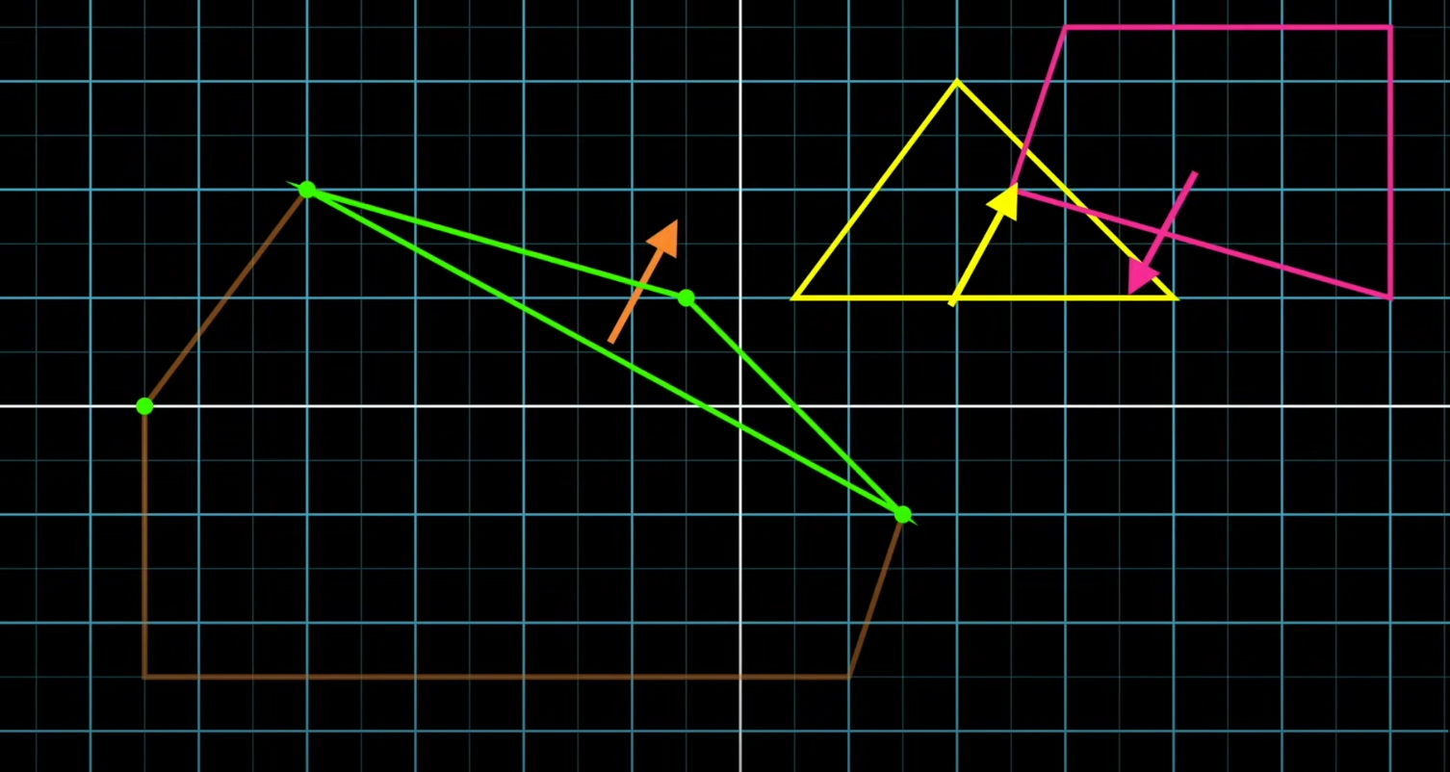
GJK algorithm

Slide 30
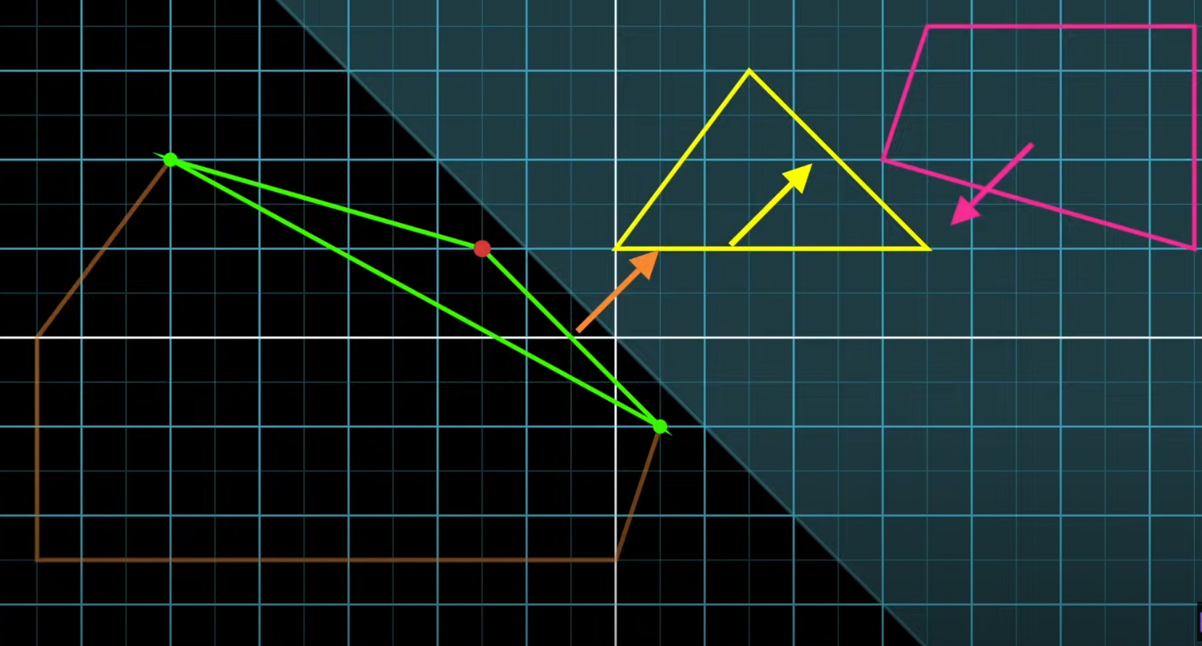
GJK algorithm

Slide 31
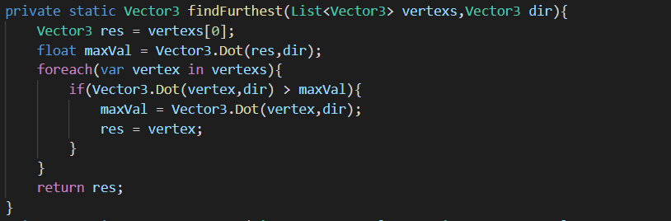
GJK algorithm
Implementation

Slide 32
GJK algorithm
Implementation

Slide 33
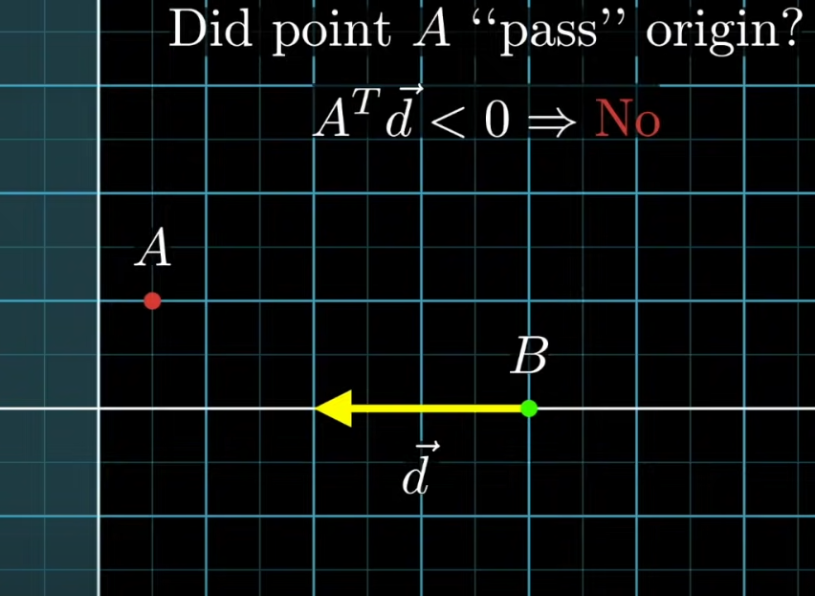
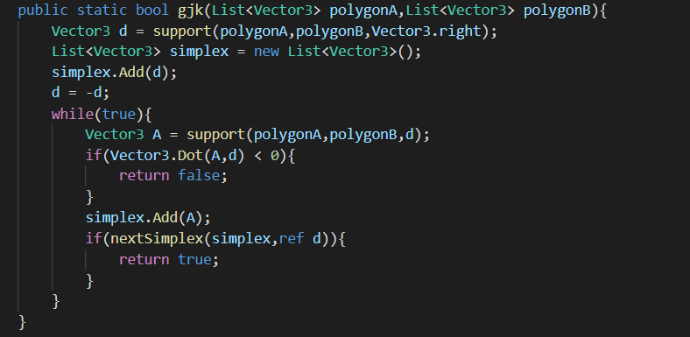
GJK algorithm
Implementation

Slide 34
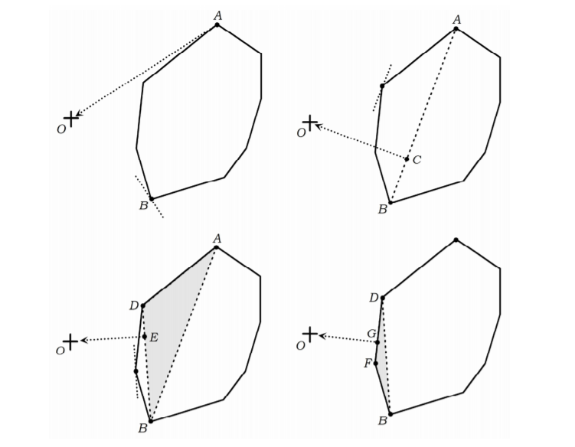
GJK algorithm
Implementation

Slide 35
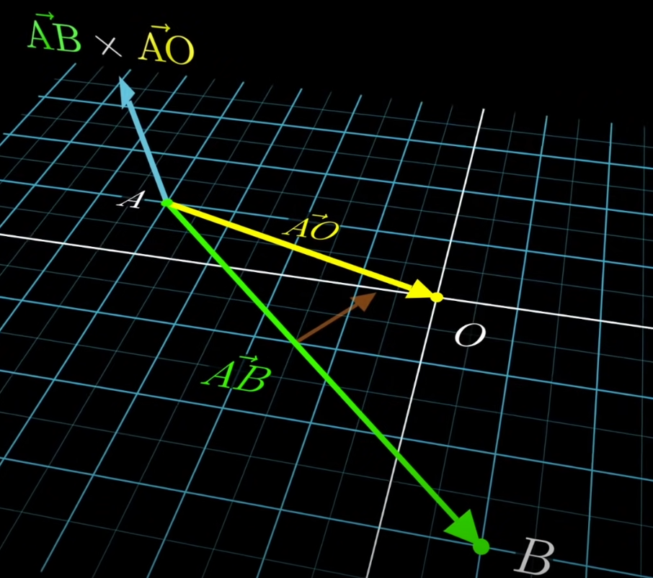
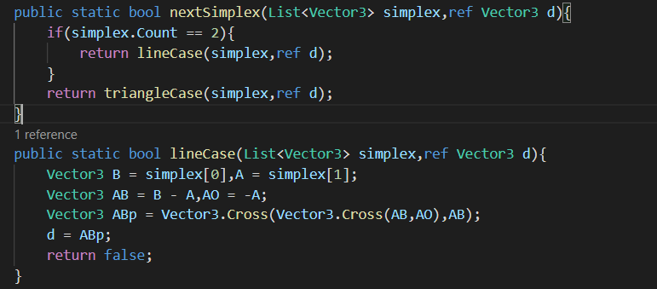
GJK algorithm
Implementation

Slide 36
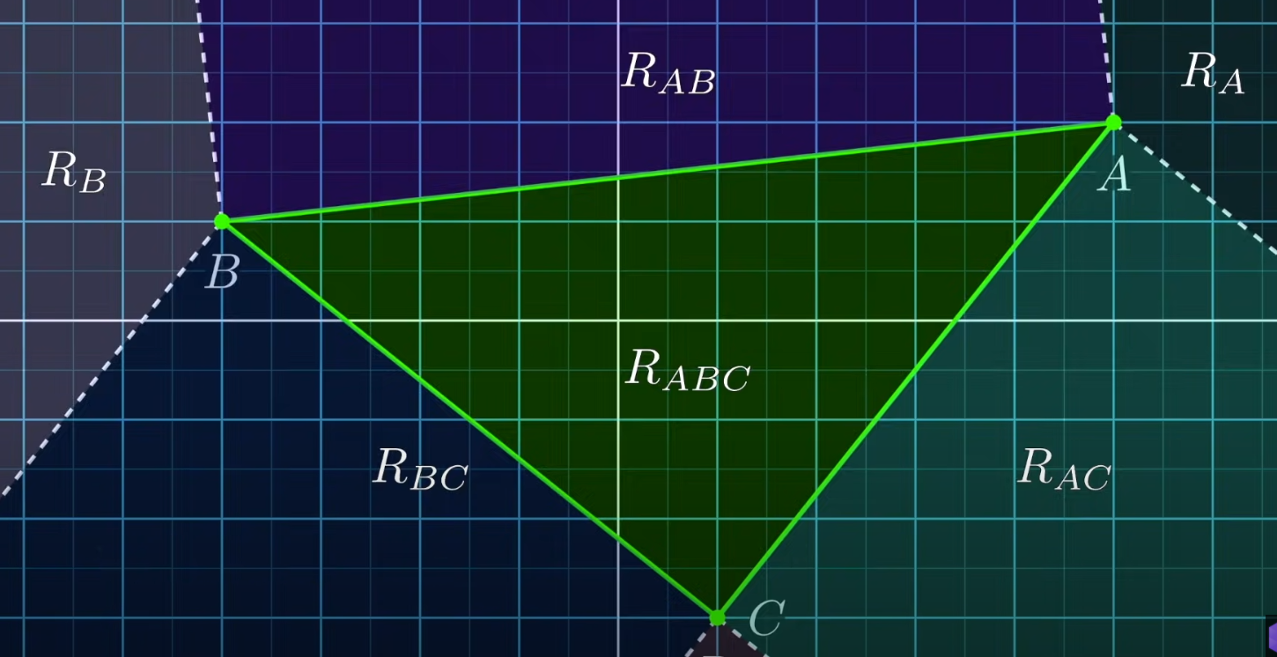
GJK algorithm
Implementation

Slide 37
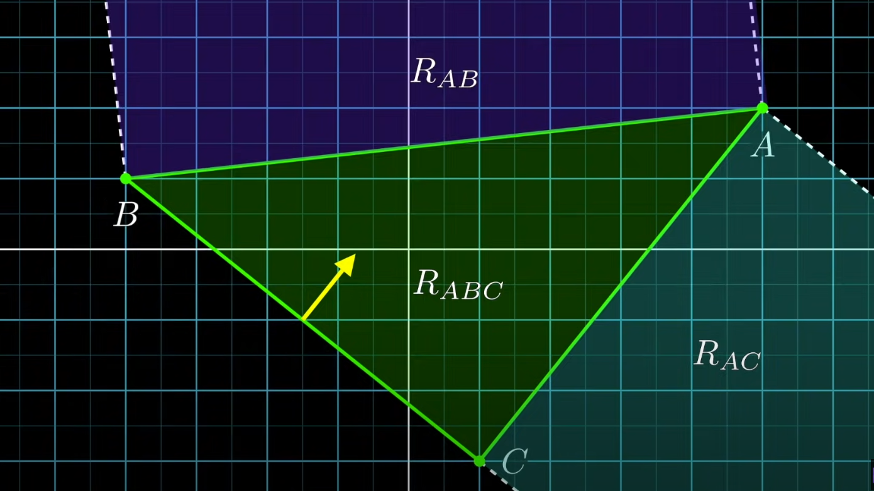
GJK algorithm
Implementation

Slide 38
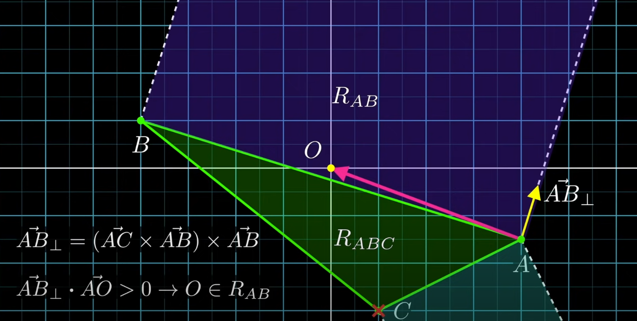
GJK algorithm
Implementation

Slide 39
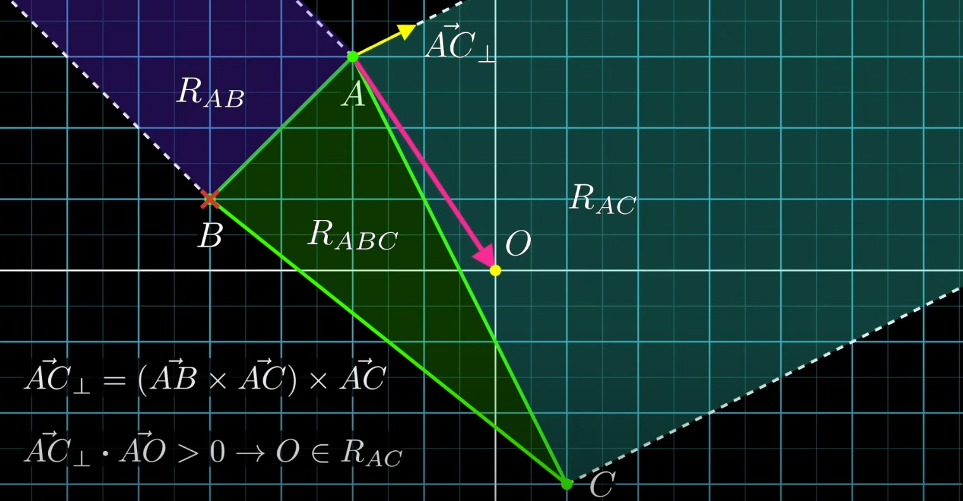
GJK algorithm
Implementation

Slide 40
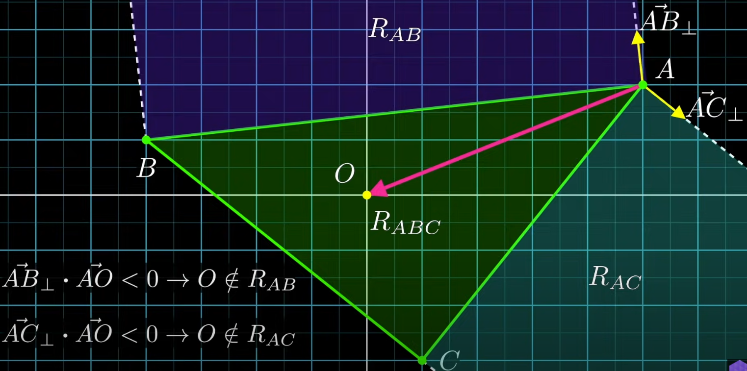
GJK algorithm
Implementation

Slide 41
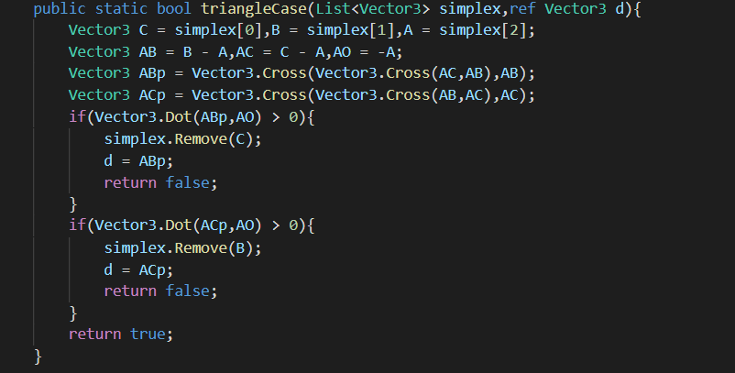
GJK algorithm
Implementation

Slide 42
03
Q&A

Slide 43
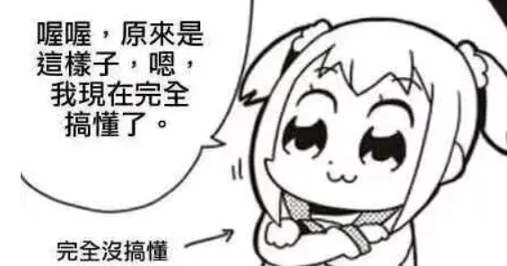
Q&A

Slide 44
reference
https://www.youtube.com/watch?v=MDusDn8oTSE
https://www.youtube.com/watch?v=ajv46BSqcK4
https://blog.winter.dev/2020/gjk-algorithm/
http://realtimecollisiondetection.net/pubs/SIGGRAPH04_Ericson_GJK_notes.pdf
https://zhuanlan.zhihu.com/p/113415779

Slide 45
GJK Demo Download
https://pan.baidu.com/s/1gu90owBuLjIF_I73eEdaQQ
kbna

Slide 46
THANK YOU

